Slide 1

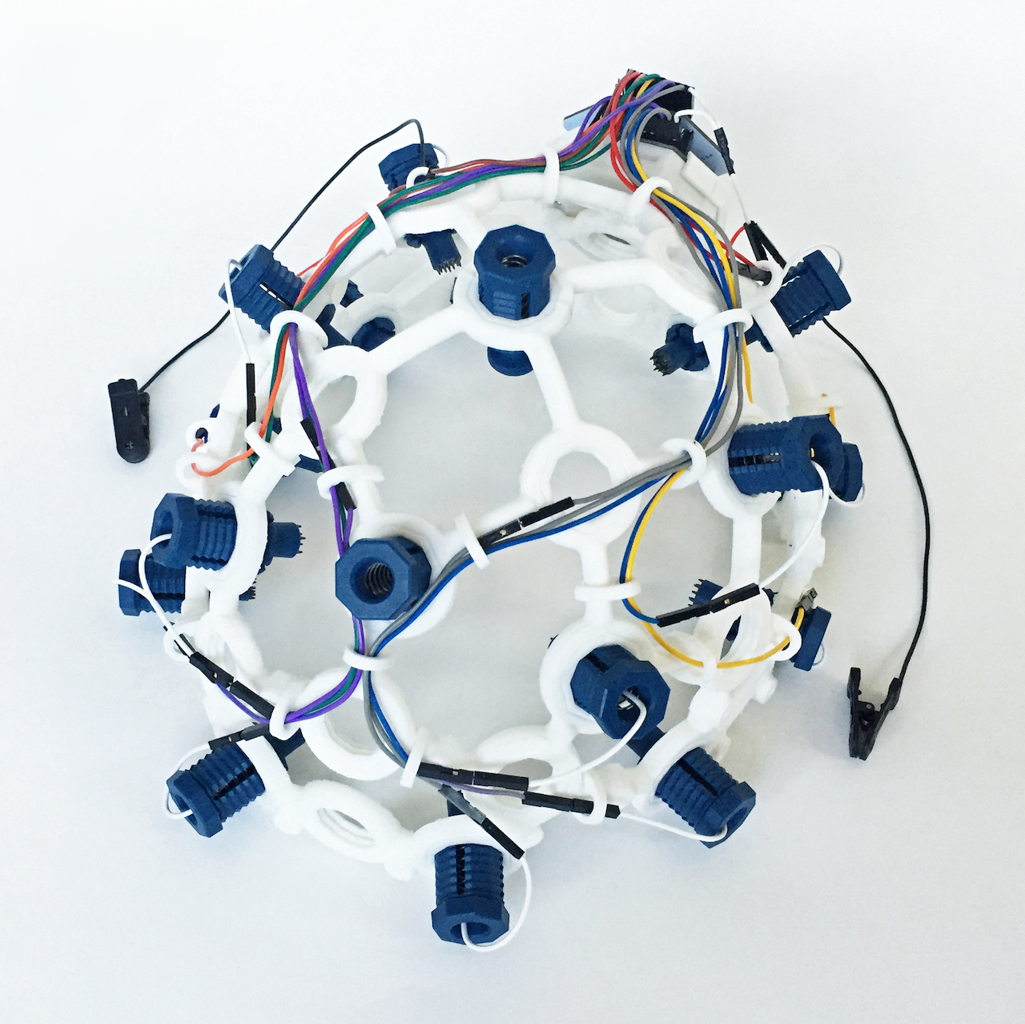
Design and Development of EEG Headsets for Paralyzed Patients
01
FYP Presentation 1

Slide 2

Group Members
Muhammad Abid Anwar
Riaz Muhammad
02
BE-VIII (POWER)
BE-VIII (ELECTRONICS)

Slide 3
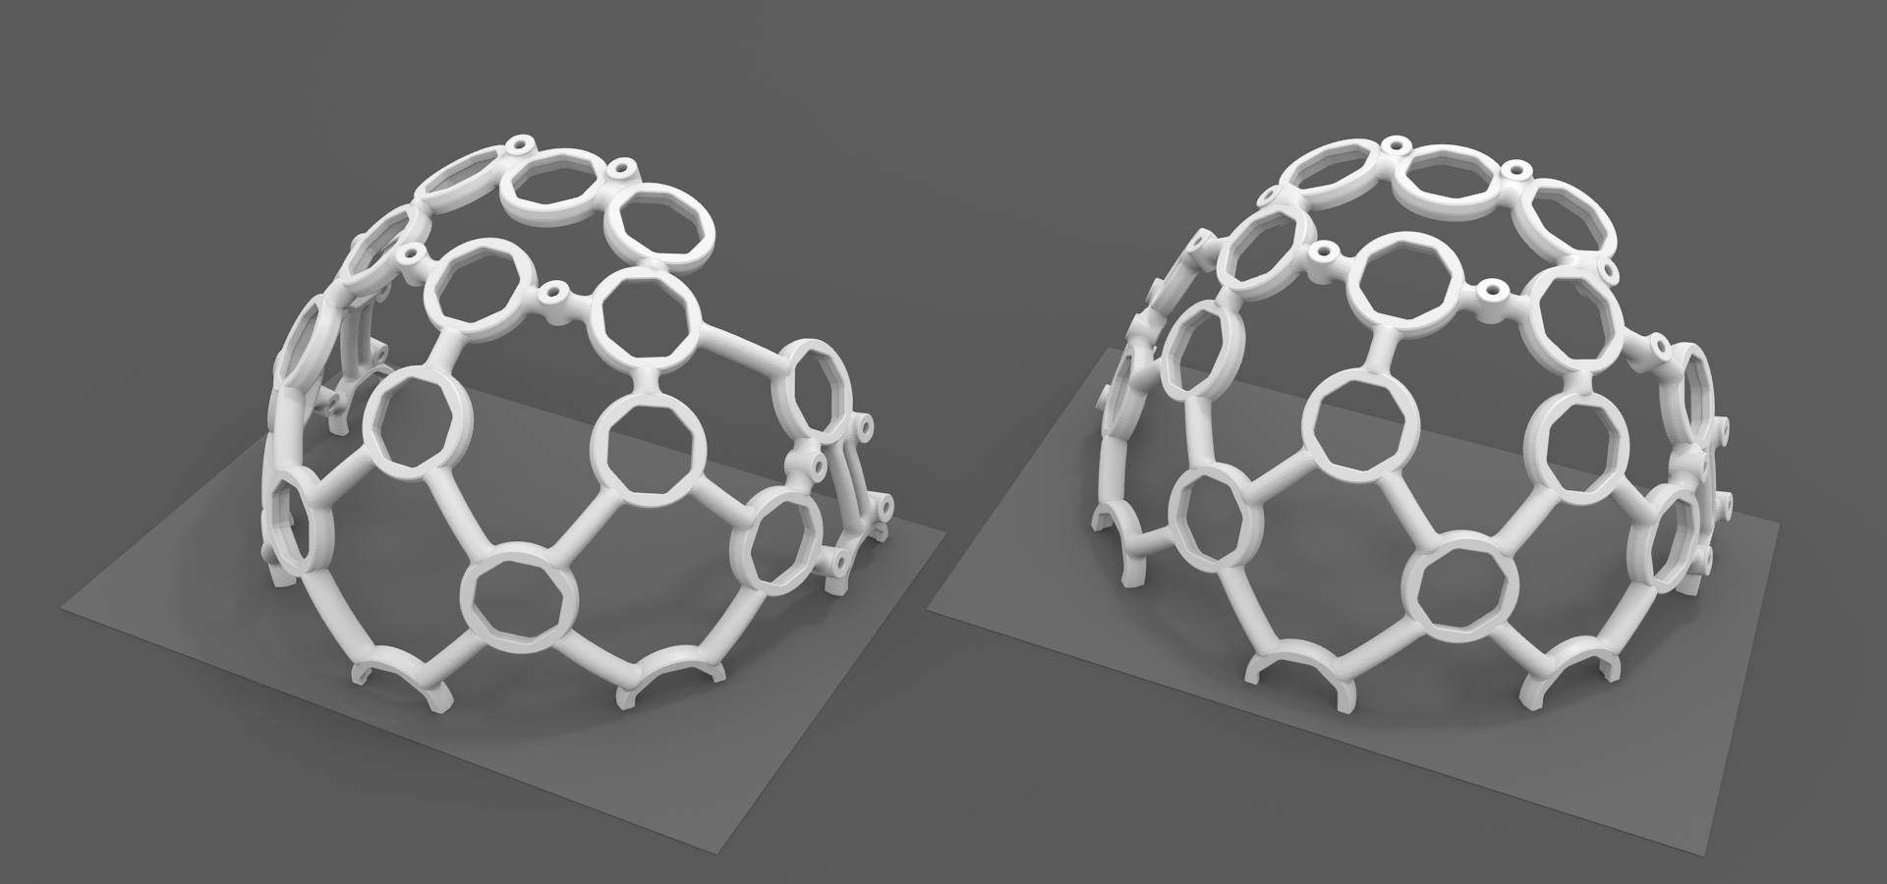
Introduction
03
Part 01

Slide 4
Background
Overview of the project
Today’s, technology is much advanced, created many ways for human beings to live their lives on their own. One of the most interesting technology is controlling such things with brain which are not even the body parts.
Human brain is made-up of billions of cells called neurons and these neurons use electricity to communicate with each other. Electrical activity called brainwaves or Electroencephalogram (EEG) signals is a technique to measure the electrical activity of brain. For recording electrical activity EEG headset is used. EEG headset convert data into packets, transmits through wireless medium (Bluetooth). Brain Computer Interface BCI system provides communicating means between headset and laptop. Brainwaves are then translated to corresponding commands through software lastly microcontroller controls external system.
04

Slide 5
The main objective is to design a system that supports patients by processing EEG signals.
Objectives
The secondary objective is to control external devices. Application of EEG based control is beneficial as it permits machines and people to flawlessly work together towards a common goal.
What we want to achieve
06
More advance benefits would involve the prediction of epilepsy episodes by acquiring several patient data and analyzing with respect to age, gender, locality and patient history parameters etc.

Slide 6
Overview of Research Methods
07

Slide 7
Related Research Articles/Papers
Title of the Paper | Main Findings
“A Review on Electroencephalogram Based Brain Computer Interface for Elderly Disabled” | In this paper they use different position for the electrode in the sculp to measure the EEG signal. And come to conclusion with right position after using different position
EEG signal analysis: a survey | In this paper they have analyzed the dynamics of the EEG signal at different stages of meditation using nonlinear parameters like correlation dimension
The EEG-Based Attention Analysis in Multimedia m-Learning | In this paper they have validated the Learning Theory for mobile learning. They have carried out the study using Neurosky Headset using attention level. Their results shows that Video based m-learning is more effective than text and text+graphic based learning.

Slide 8
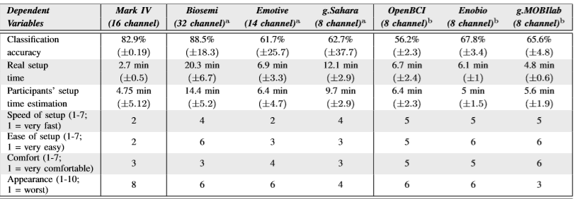
Related Research Articles/Papers
Title of the Paper | Main Findings
A Signal Processing Tool for OpenBCI | In this paper they have used c++ programming and designed a tool which reads, filtered and stored the results in a file for advance processing.
Accessible Electroencephalograms (EEGs): A Comparative Review with OpenBCI’s Ultracortex Mark IV Headset | They have compared OpenBCI Headset Ultracortex Mark IV with other headsets like Emotive, Neurosky, Muse etc.

Slide 9
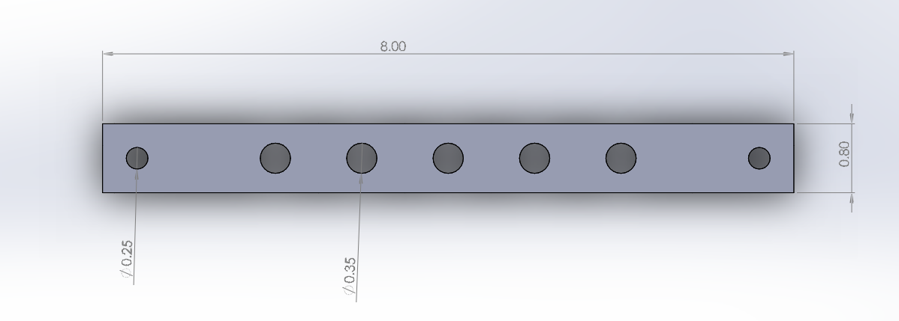
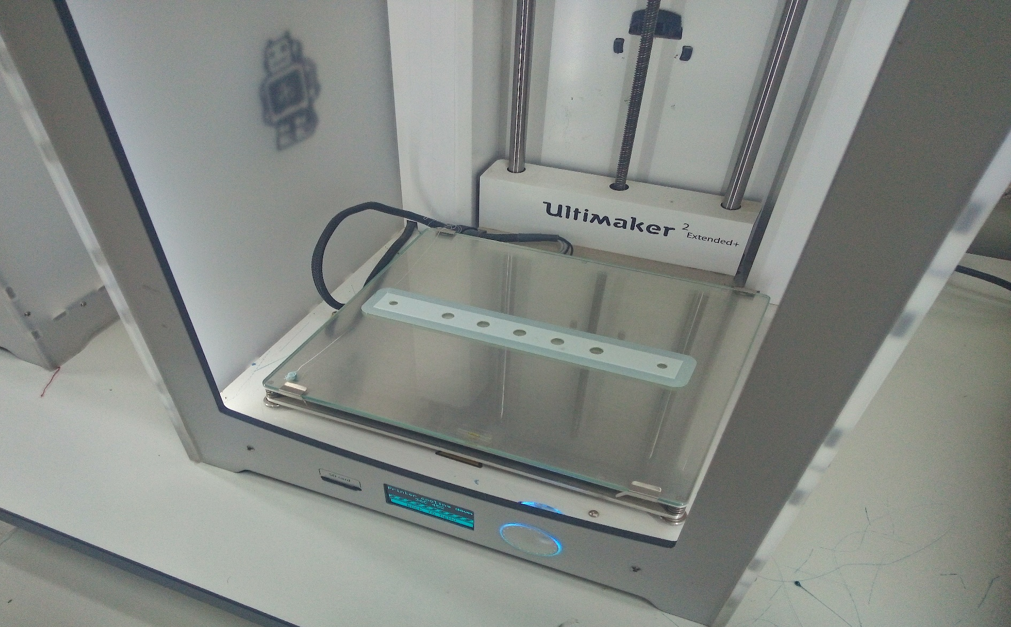
EEG Headband Kit Design
We have designed EEG Headband Kit from FAB Lab, Sukkur IBA University
The Solid Work design Parameters are given below:
Design in Solidworks-2016, with Given dimensions
While printing at FAB-Lab (@27 August 2020, 5:20 PM)

Slide 10
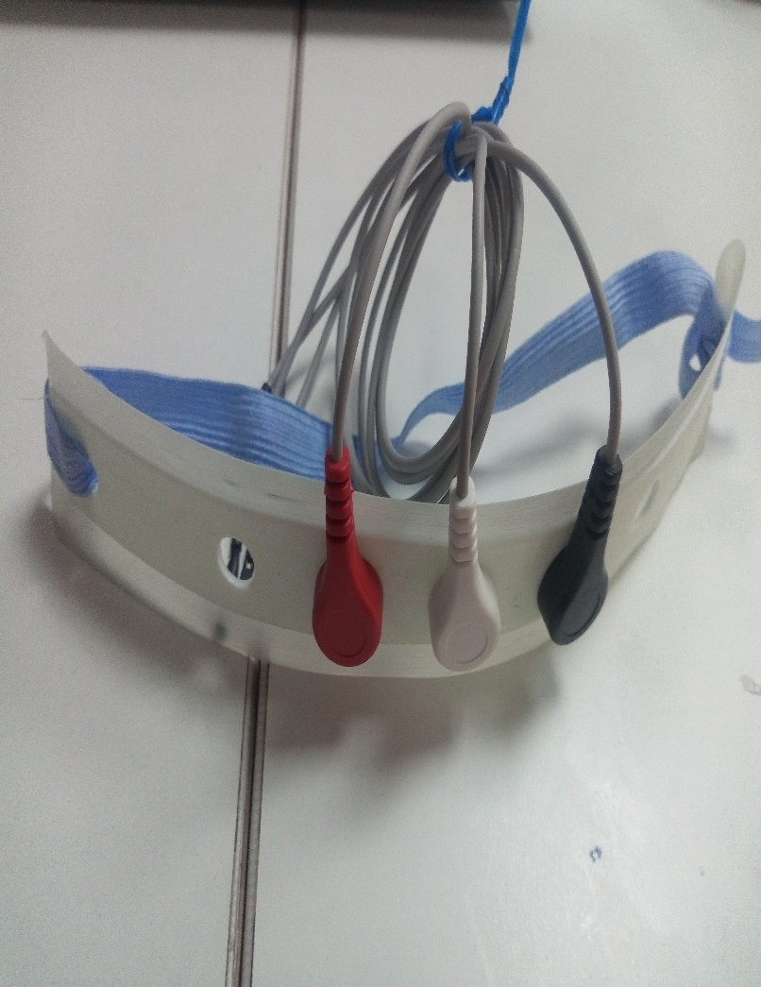
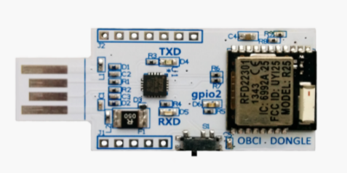
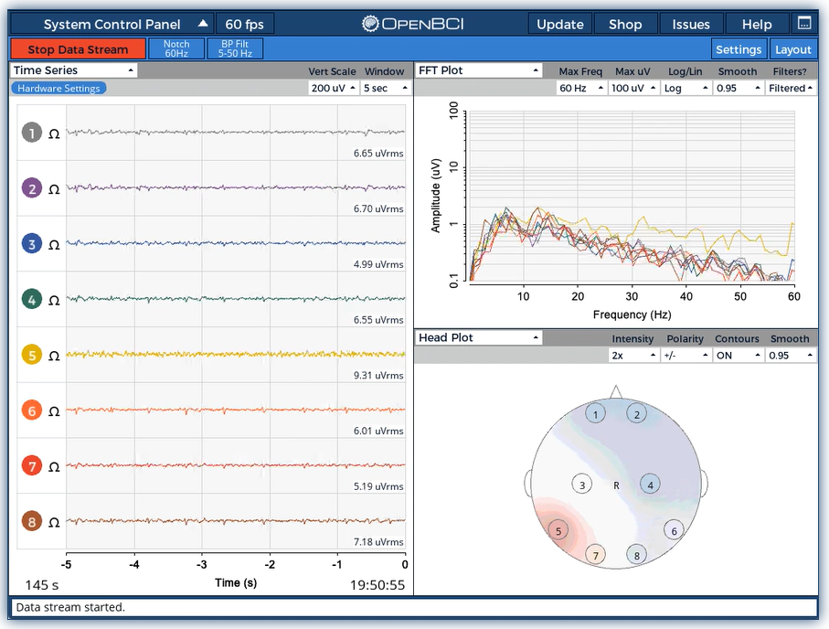
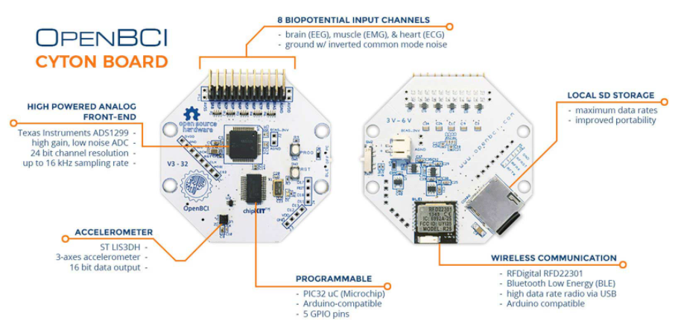
EEG Headband Kit Design (BCI Set-up)
OpenBCI USB dongle
OpenBCI Cyton Board, 8/16 Channels
EEG Headband Kit (our design)
OpenBCI GUI Software, use for:
Visualize data from every OpenBCI device: Cyton (in our case)
Send data to MATLAB
Analyze data with Python
Output data into a saved file for later offline processing.

Slide 11
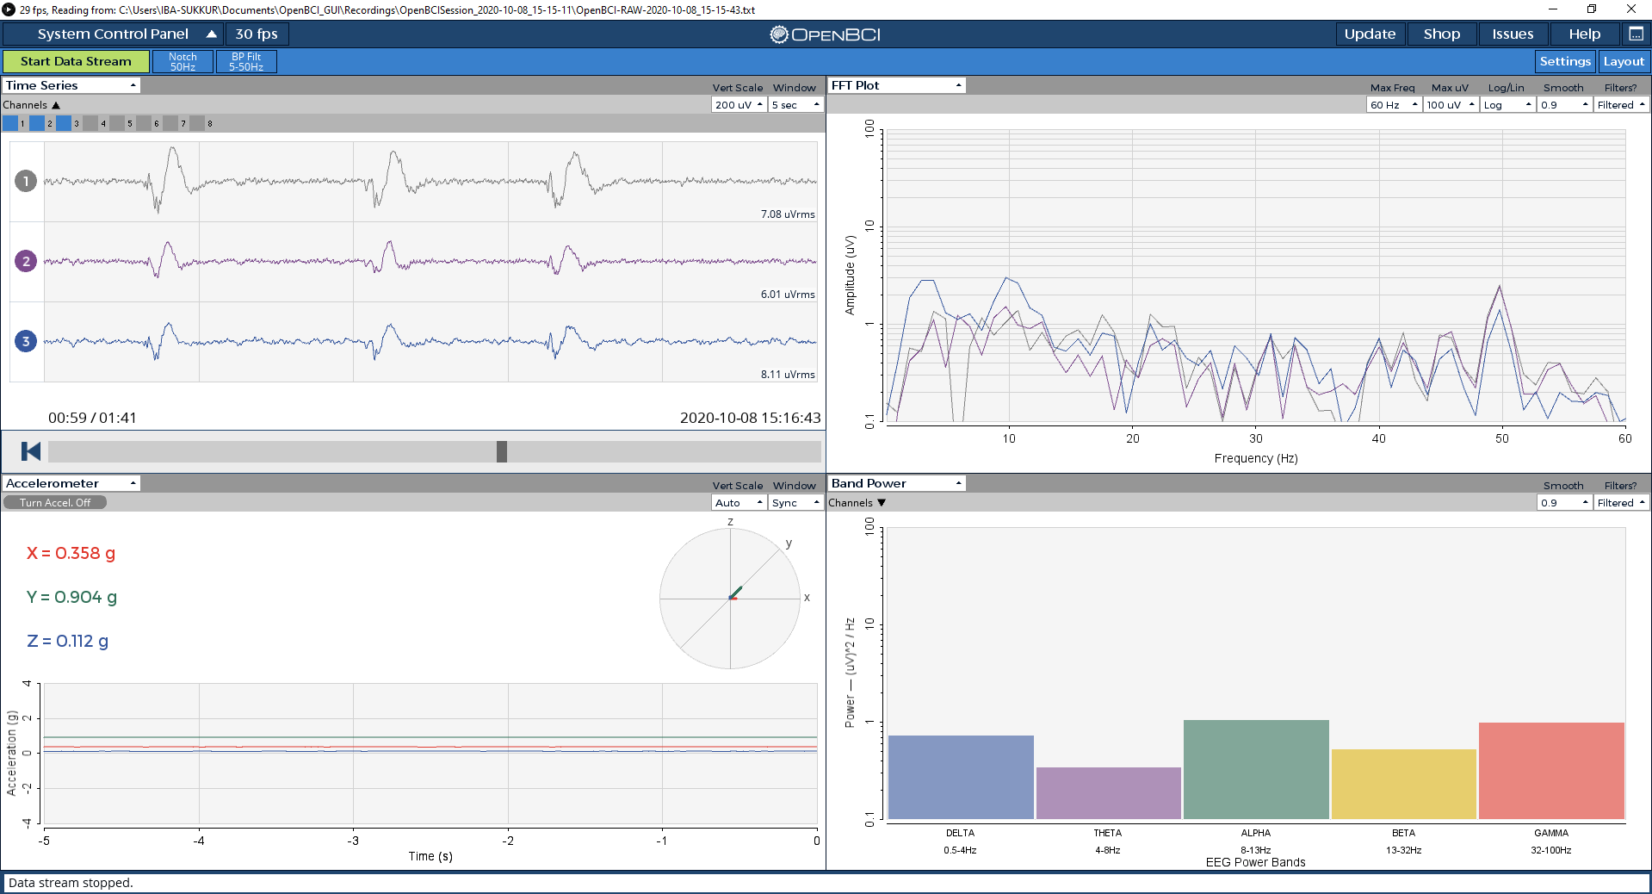
Data Acquired (Using the Headband Kit)
Eye Blinking

Slide 12
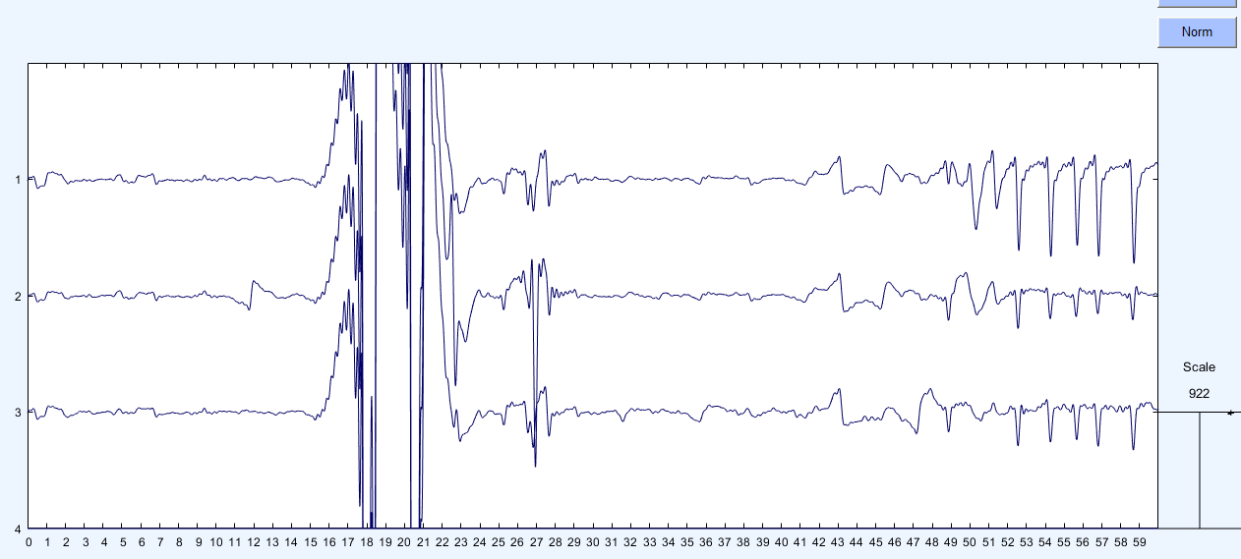
Data Processing in MATLAB (EEGLab)
Pre-Processing:
Applying Bandpass filter (0.1 to 100Hz),
Filtering > Down sampling (256 Hz) > Normalizing
Reject Noise by Eye
Fp1
Fpz
Fp2

Slide 13
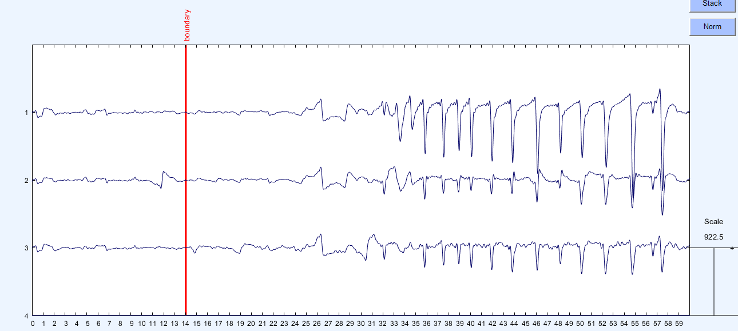
Data Processing in MATLAB (EEGLab)
The Signals after the noise is rejected
Fp1
Fpz
Fp2

Slide 14
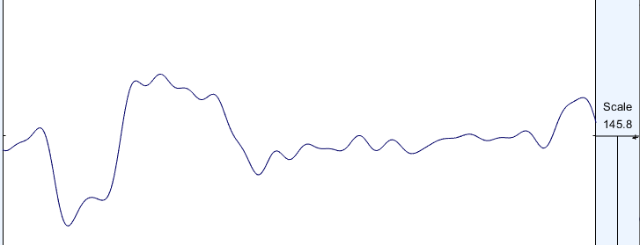
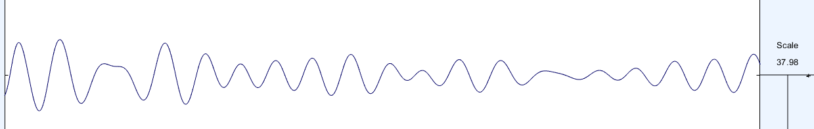
Data Processing in MATLAB (EEGLab)
0.5 to 4Hz (Delta Band)
4 -7 Hz (Theta Band)

Slide 15
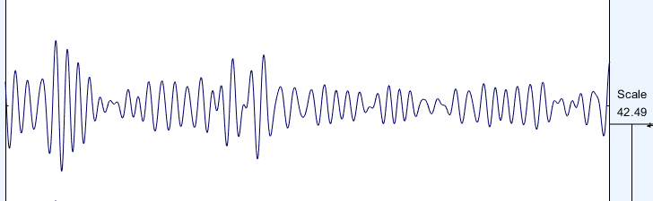
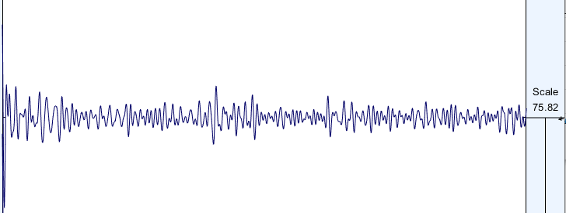
Data Processing in MATLAB (EEGLab)
8 to 12 Hz (Alpha)
12 -30 Hz (Beta)

Slide 16
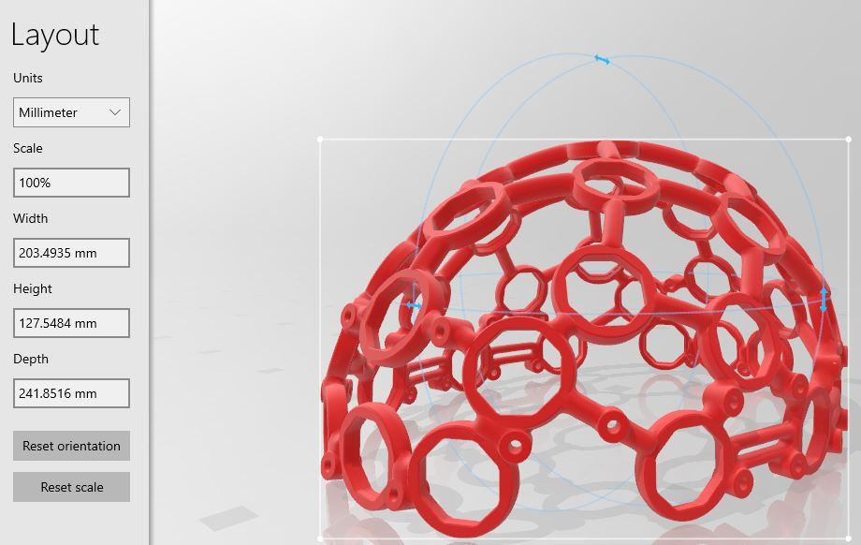
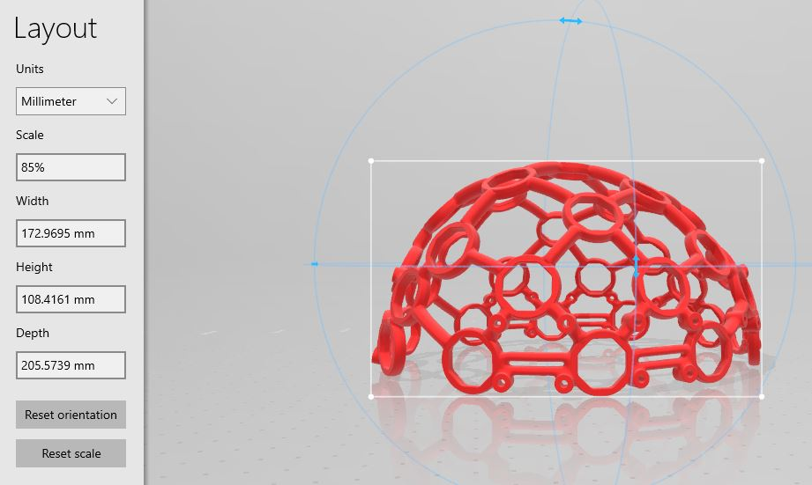
Ultracortex Mark-IV(Design in Printing Phase)
Ultracortex Mark IV is an open-source, 3D printable headset deigned to work with the OpenBCI System.
Its different parts can be printed individually, which lowers the overall cost of whole BCI System.
Limitation: The printing area of printers at of FAB-LAB is less than our design (Full Size)

Slide 17
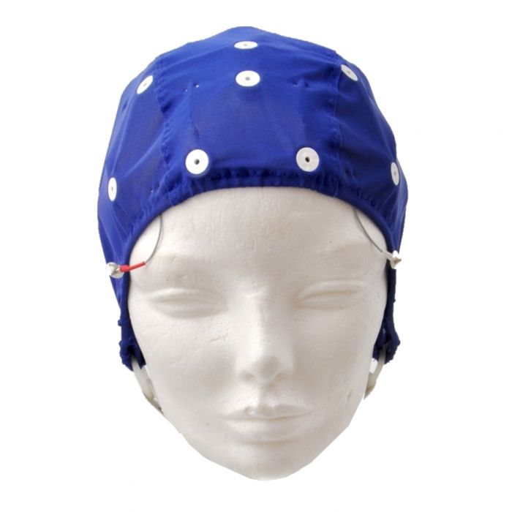
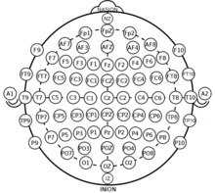
Alternative Headset (ElecrtoCap)
Features of EEG (ElectroCap):
ElectroCap is lightweight
The cost is low
We can make customized Headsets for people of different ages
It is more preferrable for longer duration data acquisition.
We can select the focus area for placing electrodes using 10-20 system.

Slide 18
Hypothesis based Experiment (m-learning)
This study will focus on the differences in learners’ attention when using three different learning media for m-learning based on EEG.
In this process, we took learning style theory as a theoretical perspective to compare the differences of the learners’ attention.
The research questions are as follows:
When learners used three media for mobile learning, which case has the highest learner attention value?
When learners used three media for mobile learning, would gender, education affect learners’ attention?
When learners use three media for mobile learning, was there a difference in attention among students with different learning styles?

Slide 19
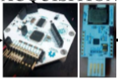
Hypothesis based Experiment (m-learning)
Acquiring EEG Signal using our designed Headset
Applying
Fourier
Transform
Separate Alpha, Gamma, Beta , Theta, and Delta
Validating the Hypothesis by comparing the Feature (SD, attention) with Quiz results
Measure Attention Level using Beta and Gamma Waves

Slide 20
Application Using OpenBCI System
We will develop an application for: “To next the presentation slides using event Related potential (eye blink)
Pre-Processing of RAW EEG Signals
Defining Threshold of ERP (i.e Eye Blink)
Acquiring EEG Signals using OpenBCI GUI
Transmit the signals from GUI using LSL
Receive the signal and detect Threshold
Control
The “Space” Key of Keyboard
Python programming

Slide 21
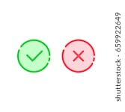

Project Timeline
Phase 02
Phase 04
3D Printing and Implementation of Proposed Scheme for Brain-Computer Interface Set up (BCI Set-up)
Analysis of Results and Conclusion +
Thesis Write-up
Literature Review and Initial Study of EEG Signals
01
02
03
04
05
Phase 01
Literature Review & Selection of EEG Headset Design
3D Design of Customized EEG Headset in Solidworks
Phase 03
Processing of RAW EEG signals &
Design and Implementation of Application using EEG signals
Phase 05

Slide 22
Conclusion
Part 04

Slide 23
Conclusion
What we have Done | What we will do
Literature Review | ElectroCap Design
Selection of EEG Device | 3D-printing of Ultracortex 4
Design of EEG Headband kit, Ultracortex Mark 4 | Hardware Assembling
Brain Computer Interface (BCI) Set-up | Experimentation – I,II,III
Acquisition and Pre-processing of EEG Data | Data Processing and Applying STFT in Matlab (Results Validation)
Feature Extraction Model (Short Time Fourier Transform - STFT) | Application Implementation
Thesis Two Chapters | Thesis Write-up

Slide 24
References
[1] Korean pediatric and adult head computational phantoms and application to photon specific absorbed fractions calculations - Scientific Figure on ResearchGate. Available from: https://www.researchgate.net/figure/Standard-head-dimensions-cm-for-five-different-ages-provided-from-the-Korean-Standard_tbl1_314114402 [accessed 25 Jan, 2020]
[2] Wan, Xin, et al. "A Review on Electroencephalogram Based Brain Computer Interface for Elderly Disabled." IEEE Access 7 (2019): 36380-36387.
[3] Shuo Wang, and Guocheng Liu ."The EEG-Based Attention Analysis in Multimedia m-Learning." Article in Journal “Computational and Mathematical Methods in Medicine”, published on 10 Jun 2020
[4] A. Aldridge et al., "Accessible Electroencephalograms (EEGs): A Comparative Review with OpenBCI’s Ultracortex Mark IV Headset," 2019 29th International Conference Radioelektronika (RADIOELEKTRONIKA), Pardubice, Czech Republic, 2019, pp. 1-6.
[5] C. Demirel, H. Kandemir and H. Köse, "Controlling a robot with extraocular muscles using EEG device," 2018 26th Signal Processing and Communications Applications Conference (SIU), Izmir, 2018, pp. 1-4.
[6] Final-year Projects using Open Source OpenEEG - Scientific Figure on ResearchGate. Available from: https://www.researchgate.net/figure/The-EEG-electrode-locations-defined-by-the-10-20-system-The-labels-F-T-C-P-and-O_fig6_281590835 [accessed 31 Jan, 2020]

Slide 25


